Slide 1
Spring 2017 – what lies ahead
Phil Graham
Graham Advisory

Slide 2
Probe data – what % of potential
 | 10 cm | 20 cm | 40 cm | 60 cm
Bungarby | 67 % | 92 % | 37 % | 13 %
Delegate | 58 % | 67 % | 33 % | 18 %
Muniong | 93 % | 89 % | 100 % | 46 %
Bukalong | 73 % | 76 % | 71 % | 61 %
Notes:
This is an attempt to give producers an idea of how much of the soil water potential is in the soil at the 31 August 2107. These figures overestimate the water available to the plant because at this stage we can not work out the wilting point. Pasture plants rarely make use of water below 60 cm for growth. They will use the water at depth to stay alive in dry times. Lucerne is an exception to this comment.

Slide 3
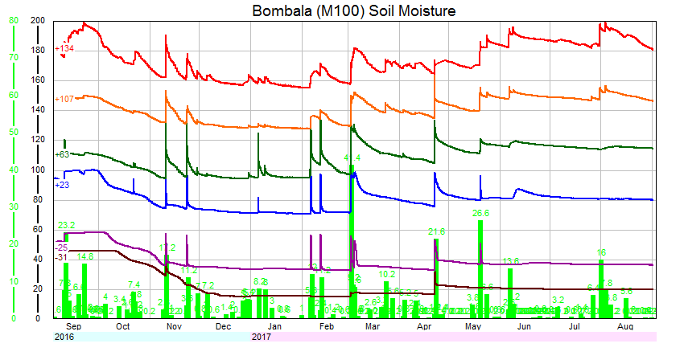
How do we read a soil probe graph
Notes:
Look along a line to see how it has changed. How does the current point on each line compare to the high and low point along the line? The red circle shows a point of waterlogging, when it goes straight up and down that is a sign there is more water than the level of soil can handle so it drains. The blue circle shows the point where the drainage has stopped, we now have a valid measure of plant available water.
Red line is 10cm, Brown is 20 cm, Green line 40 cm, Blue line is 60 cm, Purple line is 80 cm and the brown lines is 100 cm.

Slide 4
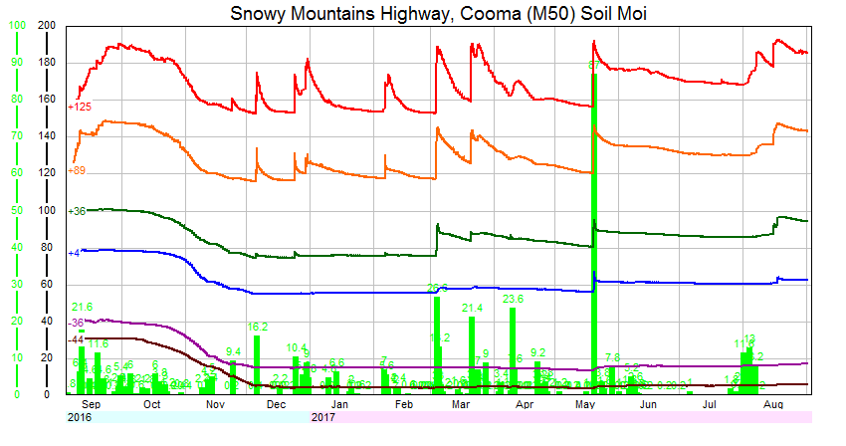
Muniong probe
Notes:
The same sensor depths apply as the previous slide. Note how the moisture has built in the 10, 20, 40 cm sensors since May. The 10 cm is at levels similar to last Sept. All the probe data will be presented differently in another month and will be accessed from the MFS home page. These probes become more useful with longer period of data.

Slide 5
Probe data – what % of potential at 31 Aug 17
 | 10 cm | 20 cm | 40 cm | 60 cm
Bungarby | 67 % | 92 % | 37 % | 13 %
Delegate | 58 % | 67 % | 33 % | 18 %
Muniong | 93 % | 89 % | 100 % | 46 %
Bukalong | 73 % | 76 % | 71 % | 61 %
Notes:
There is variation across the site due to rainfall and pasture growth. The Muniong is at 1200m elevation so moisture has built due to low /no growth. All site are on the dry side at depth.

Slide 6
Bungarby – native -4.5dse/ha
Notes:
T stands for the tactical run ie looking into the future to the end of November and H stand for the historical data based on the years from 1963 to 2016. The tactical runs are the SOLID lines and the historical runs are the DOTTED lines.
Both the historical and tactical data is based on at least 56 years of data and is displayed by 3 percentile line 25% ,50% and 75% (both T and H) for green herbage (does include frost pasture). 50% is the median year, 25% is the point where there are only a quarter of years worst than this level and 75 % is the reverse at the good end of the scale.
Between the red and green dotted lines are 50% of the years we have experienced in the last 56 years. We know how to manage them without major changes to our program. So if the tactical data, the 3 solid lines, fall within the these dotted lines then the odds are that you will not need to make major changes to management. In all years you need to fine tune your management to the seasonal condition in front of you.

Slide 7
Bungarby – improved 8.6 dse/ha
Notes:
More growth potential compared to the native therefore dries the soil quicker, so more dependent on rainfall and the 3 lines spread more. Compare the spread of the solid lines on the graphs. The better the soil moisture the tighter the solid lines will be and vice versa.
Late Sept a critical point, although the tactical lines are within a normal production window (the red and green dotted lines). This and the following sites are for an improved and well fertilised pasture

Slide 8
Bukalong 10 dse/ha
Notes:
The 3 solid lines are tight during Sept, mid Oct becomes the critical period

Slide 9
Muniong 9.7 dse/ha
Notes:
Starting from behind but always heading in positive direction, a dry spring will lead to a “tough” summer.

Slide 10
Delegate 16.2 dse/ha
Notes:
Mid Oct is the critical point. The driest site and average spring rain will cause the pasture to follow the lower lines. This site will drop to difficult pasture levels with a dry spring.

Slide 11
Delgate – varying soil moisture
Notes:
The 2 tactical runs start with a slight difference in pasture mass and different soil moisture. There is not a major difference in the lines . T had a lower starting pasture but a bit more soil moisture at the start, while T2 had higher pasture but lower soil moisture. Better to have moisture in the soil than feed on the ground would be the message from this slide.

Slide 12
Delegate green plus dead
Notes:
This slide shows the total feed that could be in the paddock, G is green an D is the dead and litter. You add the 2 25% line to get the total for that tactical run. The same logic applies the other lines. No historical data is shown in these slide.

Slide 13
NE Cooma on a loamy soil
Notes:
To provide some data for other Monaro areas a GrassGro only run was done for a loamy soil north east of Cooma, sown to an improved pasture. The model said that the top was nearly dry with some lower moisture. The spread of the 3 solid is substantial due to low soil moisture and the direction is driven by rainfall. The strong starting pasture position has been a major influence.

Slide 14
Stock condition
At all sites the fat score/condition is heading in the right direction for the enterprise. If there is a dry spring the impact on the stock comes in late summer.
Stock do well in a below average springs because feed digestibility remains higher.

Slide 15
Delegate ewe condition score

Slide 16
Bungarby improved – ewe condition
Notes:
The next 3 slide displays the fat score of the breeding adult ewes. Lambing is the last 2 weeks on sept and the turn in the lines tends to match peak milk production. Overall there are no major problem with the shape of the lines.

Slide 17
Bukalong ewe condition

Slide 18
BOM seasonal forecasts
BOM is now reporting the seasonal forecast on a fortnightly basis. A plus because if there is a major shift in factors that influence the weather then we find out quicker.
My own view is that the data at 1 month is good but don’t pay much attention after that.
Is a neutral forecast (current situation) of any use? Yes it tells us we have no strong driver pushing the odds to either dry or wetter. So neutral means we are back to the odds of rain at our locations

Slide 19
Look at rainfall history if there is a neutral forecast
September | 25% | 50% | 75%
Bungarby | 21 mm | 34 mm | 51 mm
Delegate | 28 mm | 44 mm | 60 mm
Muniong | 56 mm | 80 mm | 100 mm
Bukalong | 22 mm | 32 mm | 56 mm
Notes:
So the last 56 years of rainfall data tells us that Bungarby has a 50% chance of get above or below 34mm or it has a 75 % chance of getting more than 21 mm.

Slide 20
BOM forecast of chance of rain in Sept, skill moderate
September | 25mm | 50mm
Bungarby | 62% | 21%
Delegate | 85% | 47%
Berridale | 73% | 23%
Bukalong | 70% | 43%
Notes:
From the BOM site you can get the chance of a certain amount of rain that you select. The data on these 2 slides are the same it is just presented in different ways.

Slide 21
Summary
Except for the dry southern end the rest of the Monaro represented by the sites look like receiving a spring that sits within the normal range but at the tougher end.
The improving BOM forecast for spring means that it is unlikely that major changes to your production system will be needed due to very poor pasture.
The next 3 weeks rain will be critical to determine spring pathway.

