Slide 1
Time to die
Achilles heel. As a result, susceptible to rotational grazing
Strength of most roundworms
 | Adult worms in sheep | Eggs on pasture (days) | Infective larvae (L3) on pasture (Time for 80-90% to die)*
Barber’s pole | Months, once established (but…host immunity!) (Liver fluke: years!) | ~ 5 (but 10, 000 eggs per female worm day! (20 times the others…)) | 3 months if warm (daily max in the 20s) 6 months if cool (daily max <15) vitrinus needs cool/moist Larvae can survive frosts (‘Black scour’ L3 larvae can shelter inside the faecal pellet)
Black scour (colubriformis) |  | ~ 16 (30 in NZ)
Black scour (vitrinus) |  | ~ 16
Small brown stomach worm |  | Can overwinter?
Thin-necked intest. worm |  | Prolonged (one year?) (if dry/cold) | L3 larvae can shelter inside the egg
*This applies to barber’s pole worm (Haemonchus). ‘Scour worm’ larvae (Teladorsagia, Trichostrongylus)
can last a bit longer, perhaps weeks, because they may delay exit from faeces. ‘L3’ = 3rd stage, infective larva
Stephen Love NSW DPI, Armidale 2015-10 Sources: JN Bailey etc; L O’Connor, L Kahn etc; WormBoss, NSW DPI etc
Notes:
Check the Wormboss web site for more detail information about all species of worms.

Slide 2
To produce larvae, eggs on pasture need warmth / moisture *
 | Life span (days) | Minimum temps (daily min and max**) | Ideal temp range ºC | Moisture (rain etc)***
Barber’s pole H contortus | 5 | >10 (o/night) >16-18 (day) | 25-30 | 10-15+ mm/wk
Black scour T colubriformis | 16 | >5 >15 (day) | 25-28 | 10+ mm/wk
Black scour T vitrinus (more common in winter rainfall areas) | 16? | >2 (o/night) | 8-18 | 10+? (needs cool/moist)
Small brown stomach Tel.(Ost.). circumcincta | Can overwinter? | >4 (o/night) | 13-21 | Often enough in faeces
* In significant numbers. Clearly, for example, barbers' pole worm eggs don’t all stop dead when daily min. is < 10ºC ** the daily max may be more important than the daily min temp. *** A more accurate measure includes evaporation
Stephen Love NSW DPI, Armidale March 2012 Sources: JN Bailey etc; L O’Connor, L Kahn etc; NSW DPI, WormBoss etc

Slide 3
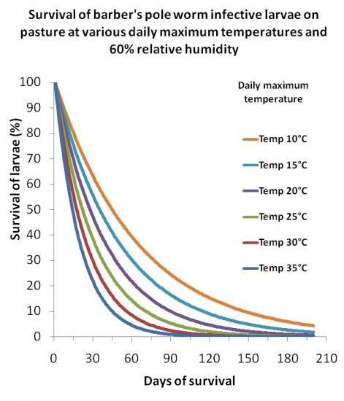
Notes:
Major point; the infective larvae (what the sheep pick up) will survive the Monaro winter. So the high number of barber pole in autumn 2016 means that there will be a “sizeable” (but declining) population of larvae still on the pastures at the start of spring. The aim should be to stop this group laying new eggs at a time that these eggs can hatch to build a new population. Slide 2 provides the info about what the weather needs to be for this too occur.

Slide 4
Impact of post weaning death rates on operating profit based on Bungarby site
Post weaning death rate % | Merino self replacing, sell wethers at 15 mths | Merino * terminal sell all lambs
Base % loss of weaners | 5% | 2%
+ 4% to base | -4.5% | -3.8%
+ 8% to base | -11.4% | -8.7%
Notes:
I have looked at the impact on farm profits from different death rates in weaners. For the merino enterprise I used a base death rate of 5% between weaning and 12 mths and 2% for the merino ewes all joined to terminals. I then increased the death rate by 4 or 8% and the impact is given as a percentage drop in farms profit/ha. In the merino enterprise this does not account for the slight loss of genetic gain due to a lower number of maiden ewes being available.
Weaner deaths are usually a combination of worms and nutrition but with barbers pole it could be directly due to worm burden. It is fair to say that some properties on the Monaro in 2016 lost more than the 8% increase that I have listed here.
This impact is coming from the loss of sale animals and wool.

Slide 5
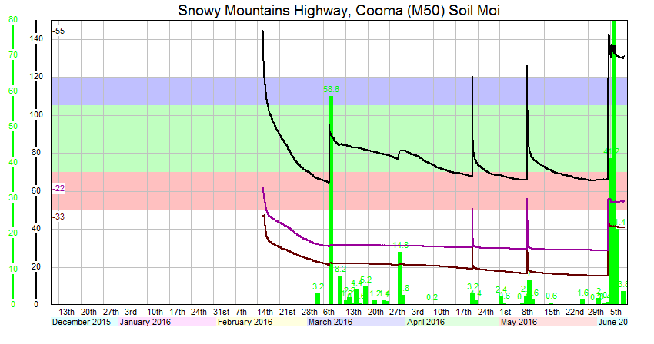
Notes:
This is an output from the moisture probes that were installed in February. It is too early to get much from the probes as we need to let the soil pack a down around the probe. The black line is shows what has happen to soil moisture to a depth of 60cm. The purple line is at 80 cm and the brown lines is at 1 m. The green bar show the rainfall events. The high spike are errors. The recent rain event has had a major impact. At present the colour section are not in the right place. I think we can assume that the low points in April were near to point where plants would have trouble extracting water for growth. We might still not have reached the point where the soil is full of water. When we know this the green band will be moved up to reflect this point. Then the green band becomes the zone where soil moisture drives our pasture growth.
The graph will continue to be refined to improve the info that it provides. It will be mid spring before we have confidence about the data.

Slide 6
