Slide 1
The Monaro
‘no better place to farm’

Slide 2
We have not benchmarked the full range of seasons yet

Slide 3
MFS Enterprises

Slide 4
Value for money
Notes:
6 in room

Slide 5
Choice of enterprise is not likely to be a long term differentiator

Slide 6
Profits are driven by margins
Notes:
60% equity v 75% equity
Anderson, Bellinger, Green, Johnston, Grimshaw

Slide 7
Benchmarking to find the issues that are driving margins

Slide 8
Benchmarking to find where the optimums are

Slide 9
Benchmarking to find the appropriate levels of expenses

Slide 10
What might be different about the Monaro
Optimum stocking rates relative to rainfall may be lower.
Optimum lambing/calving dates will be different.
Most suitable target markets might be different.

Slide 11
Identifying the efficient production systems for the Monaro
Notes:
$7/kg clean, 6kg clean/Ha/100mm
$3/kg Dwt, 20kgDwt/Ha/100mm

Slide 12
Two levers need to be pulled to maximising wealth creation in a farm business
Operating efficiency – 6% ROAM
Leverage – 30% debt.

Slide 13
Questions

Slide 14
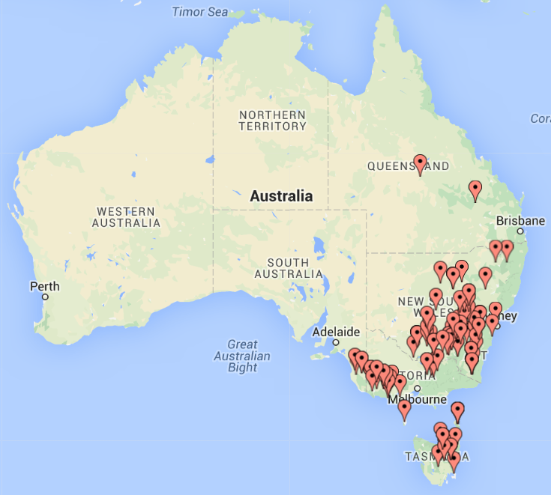
Long term most profitable and what they do

